Slide 1
New Digital Technology Hub for MIT
By : Brodie and Nikhil

Slide 2
AIM & objectives
To simplify the use of Digital Technologies website for students for checking their course outline, timetable, or even career development and much more.
We will complete the scope this by doing the following:
Going online and looking at other colleges, institutes or universities and see what information they display on their programs web pages. For this step we will look at 4 located in the USA and 2 local here in New Zealand. Design of the webpages
Compare what functionalities these websites have with what the current MIT page does or doesn’t have.
Apply what we feel will benefit the MIT webpage to the new website we are creating.

Slide 3
Changes done
Geolocation map for MIT
Section of Career Development
Units needed for the 3 majors
News and Events – In and Out of MIT added
Section for Lecturer Profiles
Information updated

Slide 4
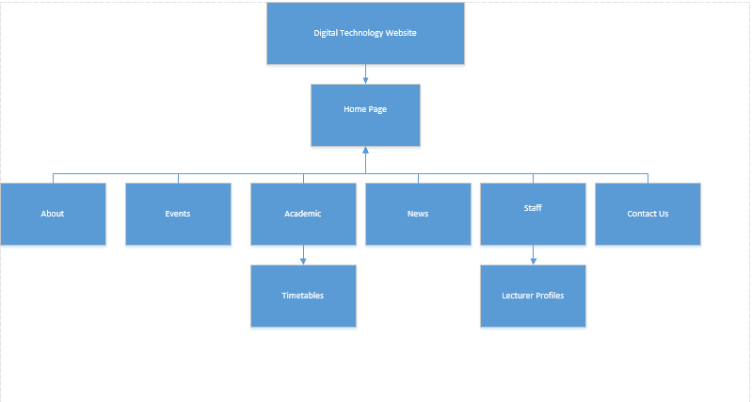
Navigation DIagram

Slide 5
Programmes Used
Wamp for hosting
WordPress for platform
Visual Studio Code

Slide 6
Learning Curves & Limitations
We had to learn php coding as well as WordPress platform which was a big challenge
Research had to be gathered from other universities of how they’ve structured their Faculty of Computer science
Time management – Work, Uni , Second Unit

Slide 7
Future work
Career development for the 3 Majors
Class locator – Empty or Occupied
360˚ view of MIT and Levels
Get functionalities working 100%

